Slide 1
Memory Statistics

Slide 2
Observability Profiles
Observability Profiles | Insights | File Name
L3 Cache Stats | L3 cache hits/miss, miss rate | L3CacheStats.py
Paging Operations | page faults, re-faulted pages, Swap in/out stats | PagingOperations.py
Swap IO Overhead | pages read from & written to swap memory | SwapIOOverhead.py
User Space Memory Alloc and Dealloc | trace the malloc & free count | UserSpaceMemoryAllocAndDealloc.py
VM Stats | RSS, PSS, Free & Available Memory | VMStats.py
Memory Management Events Tracing | Kswapd, OOM killer, kcompact stats | MemoryManagementEventTracing.py
PSI Stats Resource Pressure | Memory & CPU psi stats | PSIStatsResourcePressure.py

Slide 3
L3 Cache
Built on Motherboard
Used to help L1 and L2
Sends information to L2
the Level 3 cache acts as a shared storage pool that the entire processor can access
It is far slower than L1 and L2 cache
Modern CPUs now almost exclusively have L3 cache onboard for greater efficiency.

Slide 4
Code Explanation
Comments and import
Argument parsing to parse command line arguments
Bpf_text includes two functions cache miss and cache reference
An object of BPF class is created. It uses hash tables to do this.
In try and accept block trying to attach the eBPF programs to hardware events related to cache misses and cache references.
Main loop running until we press Ctrl C which creates a SIGINT signal to stop running
Calculation of total misses and hits and printing their values.
Output of this contains PID, TID (Thread ID), process name, CPU, cache references, cache misses, and hit rate.

Slide 5
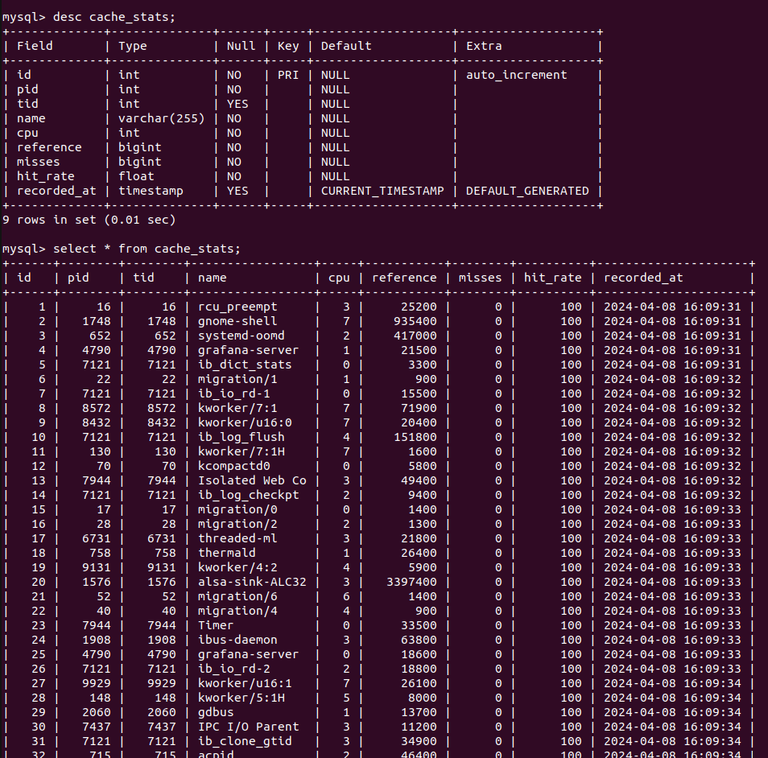
Database Structure and Output

Slide 6
Paging Operations
Paging
Static memory allocation method
lets the operating system fetch processes from secondary memory in the form of pages and place them in the main memory
A page is a logical memory unit in a program
Logical memory is organized into equal-sized pages or equal-sized blocks.
A frame is a type of physical memory unit.
In paging, physical memory (main memory) is organized into frames, which are equally sized memory blocks.
If a process has n pages in local memory, there must be n frames available in the system.

Slide 7
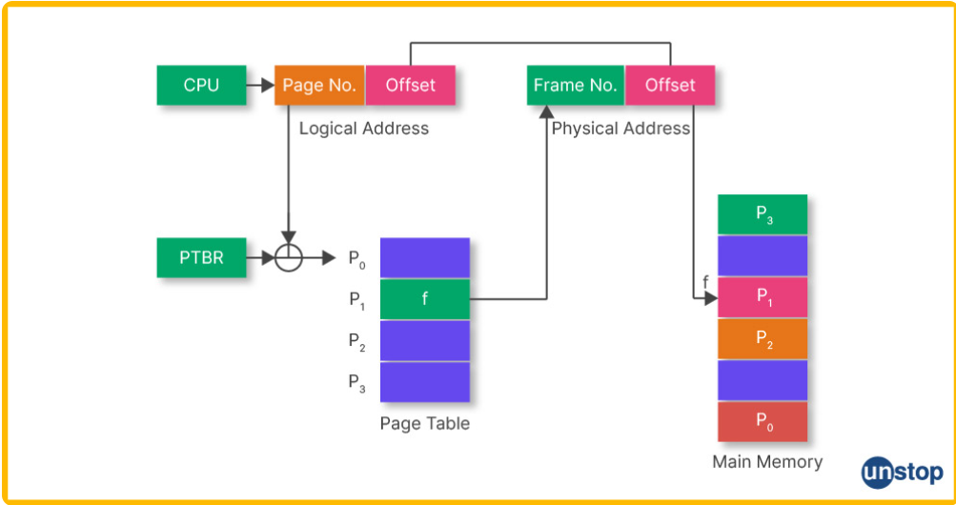
In this way paging is done.

Slide 8
Insights of Paging
Page Faults
A page fault is an exception raised by the memory management unit that happens when a process needs to access data within its address space, it fails to load in the physical memory.
Re Faulted Pages
"Page re-fault" means where a page that was previously evicted from physical memory (RAM)and stored in secondary storage needs to be brought back into RAM because it is again required by a process or program.
Swap In/Out
Whenever a page fault occurs a new page is bought in from secondary storage which is swap in and a page is being taken out which means swap out

Slide 9
Page Fault Code
Uses Histogram to calculate Page Faults
function trace_page_fault that increments the page_fault_count histogram by 1 whenever a page fault occurs.
BPF object b and loads the BPF program code into it using the provided text
Attaches the trace_page_fault function to the handle_mm_fault kprobe. This means that every time the handle_mm_fault function is called, the trace_page_fault function will be executed.
Main Loop until Ctrl+C is pressed
Gets pae fault count histogram and then iterates over that and prints count for each key
Uses b.kprobe_poll() to poll and handle any pending kprobe events.
A Kernel Probe, or kprobe, that allows developers to attach a callback function (probe) to a specific location in the kernel code.
Output is key and count where key is bucket identifier
a "bucket" refers to a specific category or range into which the counted values are grouped.

Slide 10
Page Re-Fault Code
Use two histograms (page_fault_count and refaulted_page_count) to count events.
trace_page_fault: The BPF program function. It extracts the pid from the current context and increments the count for the corresponding PID in the page_fault_count histogram. It also increments the refaulted_page_count histogram by 1 for each page fault.
Create BPF Object b
attach_kprobe: Attaches the BPF program to the handle_mm_fault kernel function. This means that the trace_page_fault BPF program will be executed when the handle_mm_fault function is called.
Main loop here prints the refaulted page count for each process.
The output of this contains pid and page refault count for each of processes

Slide 11
Swap IN/Out Stats
Comments and import
Argument parsing to parse command line arguments
BPF Program to count swap ins using hash tables.
The kprobe__swap_readpage function is triggered by the swap_readpage kprobe, and it increments the count for the corresponding process.
Main Loop until Ctrl+C is pressed
Retrieves and prints swap-in counts from the counts hash table.
Output for this is Timestamp,Process Name,Process ID, Number of Swap Ins

Slide 12
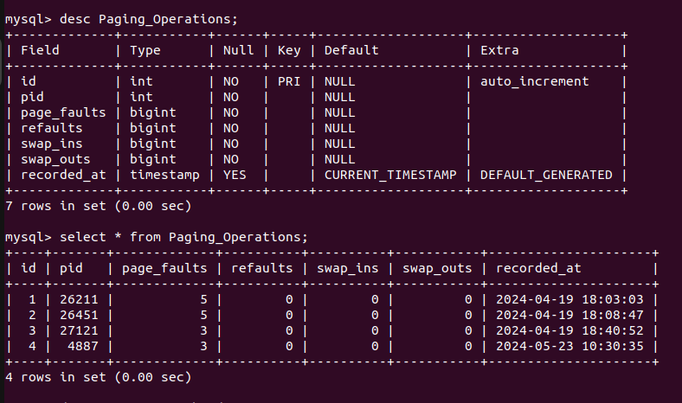
Database Structure and Output

Slide 13
Swap IO Overhead
Swap I/O overhead refers to the performance impact incurred when the operating system needs to use swap space on disk for virtual memory management.

Slide 14
Code Explanation
It defines swap_readpage and swap_writepage functions for accessing swapins and swapouts.
Defining BPF object
Enters main loop and prints output at regular intervals until Ctrl+C is pressed.
The output of the above code contains process Name Process ID and type(SwapIn or SwapOut) and the corresponding page address.

Slide 15
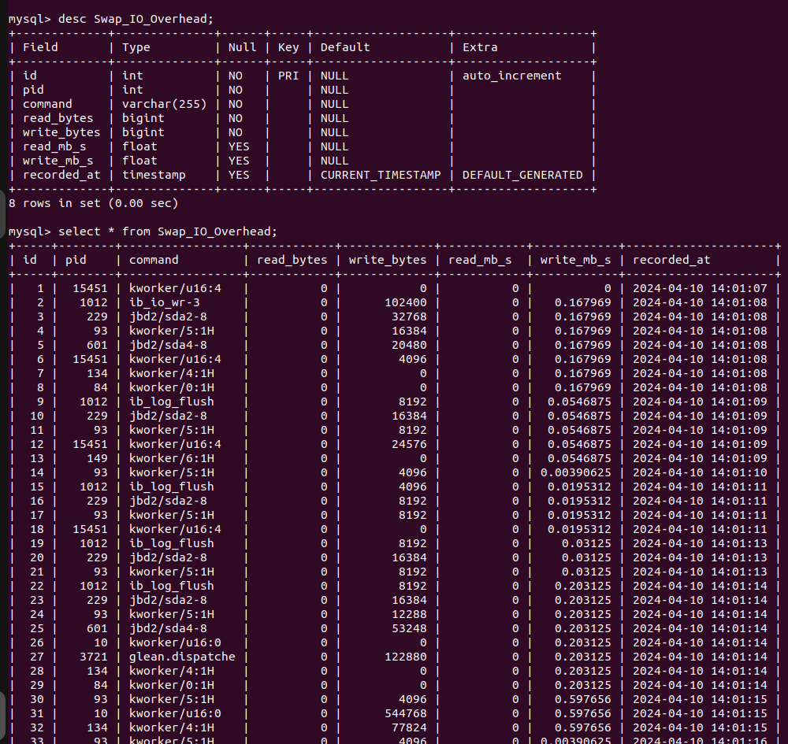
Database Structure and Output

Slide 16
User Space Memory Allocation and Deallocation
User space means User mode memory
Memory allocation is the process of reserving a block of memory for a specific purpose during the execution of a program.
Memory deallocation is the process of releasing previously allocated memory when it is no longer needed to prevent memory leaks and efficiently use system resources.
A memory leak occurs when memory that has been allocated is not deallocated, leading to a gradual increase in memory usage over time.
Malloc means allocating memory
Free means deallocating memory

Slide 17
Code Explanation
Defines two functions trace_alloc and trace_free to track allocations and deallocations using hash maps in bpf_text.
Creating a bpf object
Attaching trace_alloc to malloc and trace_free to free functions
Main loop running until we press Ctrl+C.
Traces allocations and deallocations and stores in hash maps.
Retrieves and prints the count of each and then clears the hasp map.
Uses b.perf_buffer_poll() to poll and handle any pending events.
Output for this is will have two sections Allocation and Deallocations and in each section for each address the count of the respective thing will be printed

Slide 18
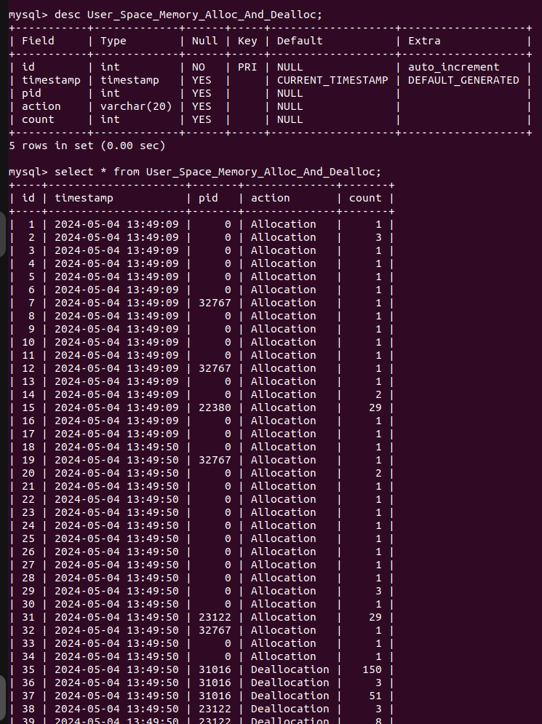
Database Structure and Output

Slide 19
Virtual Memory Stats
Virtual memory is a memory management technique where secondary memory can be used as if it were a part of the main memory.
When an application is in use, data from that program is stored in a physical address using RAM. A memory management unit (MMU) maps the address to RAM and automatically translates addresses.
If, at any point, the RAM space is needed for something more urgent, data can be swapped out of RAM and into virtual memory.

Slide 20
Insights
RSS:- RSS stands for "Resident Set Size.The RSS value indicates the amount of physical memory actively used by a process.RSS represents only the portion of memory in RAM and does not account for memory that may be paged out to disk (swap space).
PSS:- PSS stands for "Proportional Set Size." PSS is a memory metric that takes into account the shared memory pages among multiple processes. It calculates the portion of each shared page that should be attributed to each process using that page.
PSS = (Shared Memory / Number of Processes Sharing) + Private Memory
Free:- The term "free memory" represents the portion of RAM that is available for allocation to processes or for use by the operating system
Available Memory: The term "available memory" represents the total amount of memory that is currently unused and can be quickly allocated to processes or used by the operating system for various tasks.
While free memory provides information about memory that is not currently allocated, available memory provides a more inclusive view by considering cache and buffers that can be quickly reclaimed if needed.

Slide 21
Code explanation
There is a command
Free -h
Which will give many stats out of which we can take free and available memory.
So for RSS and PSS we need to install a library named smem with
Sudo apt install smem
Then we can run the command
smem

Slide 22
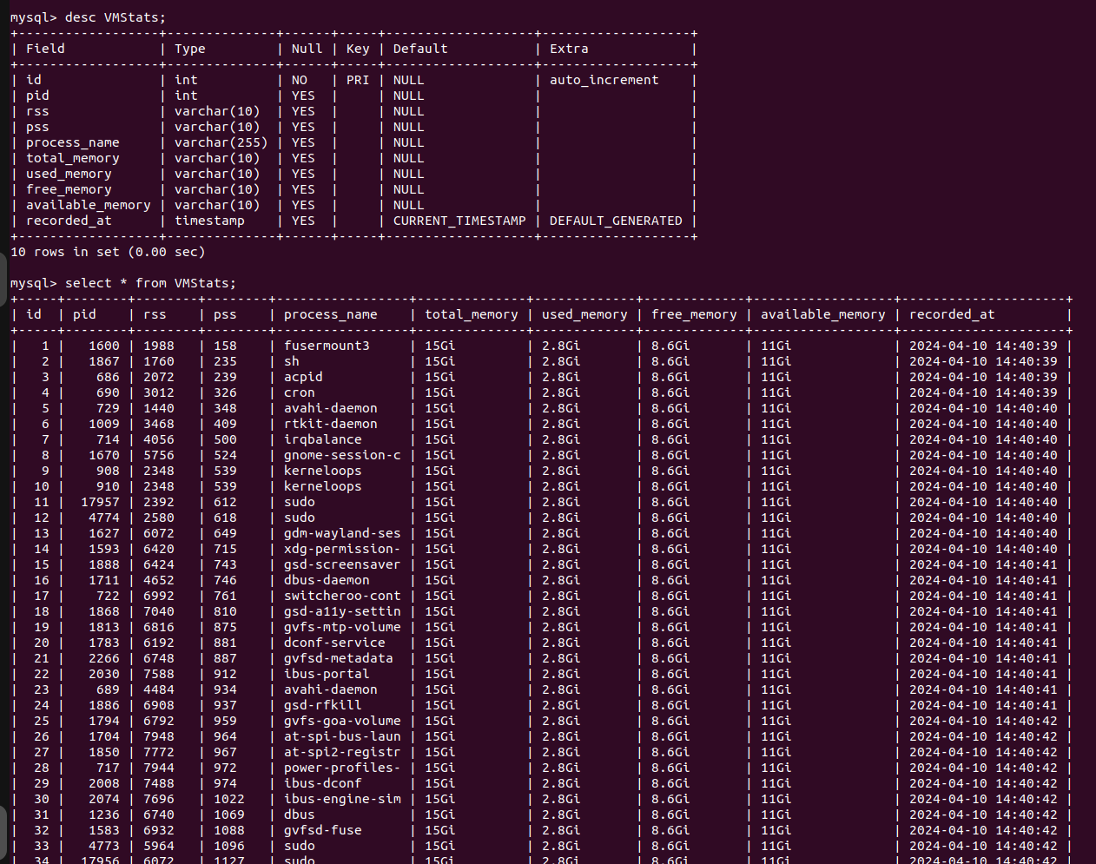
Database Structure and Output

Slide 23
Memory Management Event Tracing
Memory management event tracing involves monitoring and capturing events related to the allocation and deallocation of memory in a computer system.
Kswapd:- is a kernel thread in the Linux operating system that is responsible for managing the swapping of pages between physical memory (RAM) and swap space on disk. Its primary goal is to free up memory pages in RAM by moving least recently used (LRU) pages to the swap space when the system is under memory pressure.
OOM Killer:- When the kernel determines that it can no longer meet the memory demands of the running processes, it invokes the OOM Killer to select and terminate one or more processes to free up memory and prevent a system crash due to lack of available resources.
Kcompact:- DEFINITION AND EXPLANATION NOT FOUND

Slide 24
Code Explanation Kswapd
There is a command called
cat /proc/vmstat
So this will print a lot of output from that we can get the kswapd count. But this will only give the kswapd count.
Code done

Slide 25
Code Explanation OOM KIller
Specifies the path to the file that contains system load averages.
a BPF program that traces the oom_kill_process function.
a BPF program that traces the oom_kill_process function and captures all relevant information
A function print_event to print all the data
Main Loop running until Ctrl+C is pressed
Creates a buffer object
The output contains the timestamp and the triggering process (fpid), its command name (fcomm), the terminated process (tpid), its command name (tcomm), the number of pages involved in the OOM kill (pages), and the system load averages (loadavg) are printed for each event.

Slide 26
KCompact Code Explanation
There is a command called
grep compact /proc/vmstat
So this will print a lot of output from that we can get the kswapd count. But this will only give the kcompactd count.
Code done

Slide 27
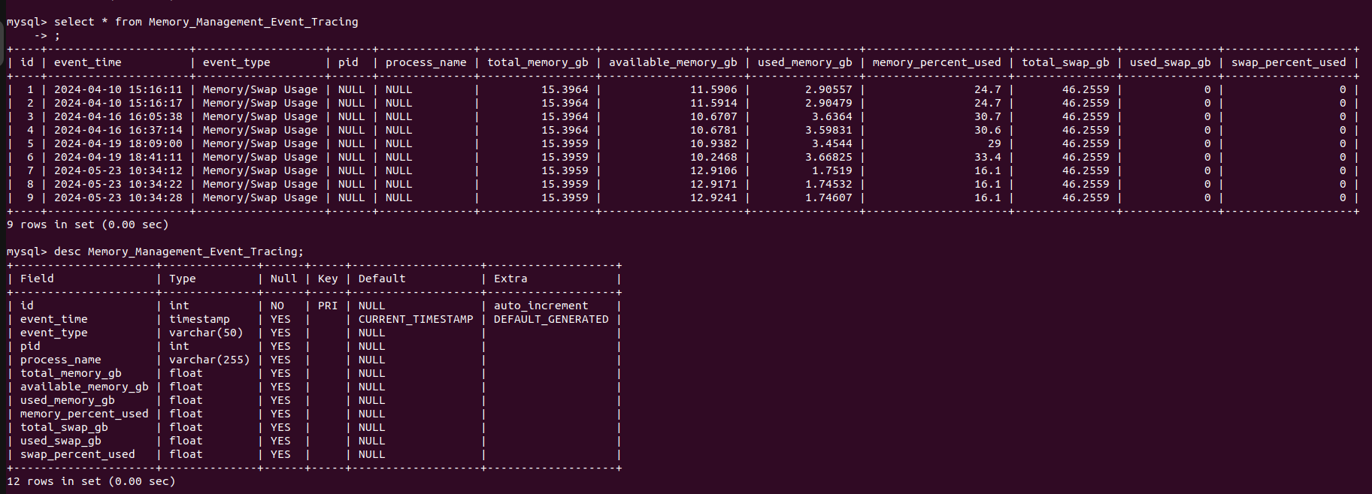
Database Structure and Output

Slide 28
PSI Stats Resource Pressure
To identify periods when processes are stalled due to resource shortages.
PSI for CPU:- PSI CPU metrics include psis, psir, psiw, and psi_cpu which represent the number of processes that are running (s), waiting for CPU (w), and waiting for CPU due to RCU (r), respectively.
Memory:- PSI Memory metrics include pswp, pswpu, pswpd, and psi_memory which represent the number of processes swapping pages (pswp), the number of processes waiting for uninterruptible swap I/O to complete (pswpu), the number of processes waiting for page faults to be resolved (pswpd), and a summary metric providing an overall view of memory pressure.

Slide 29
Code Explanation

Slide 30
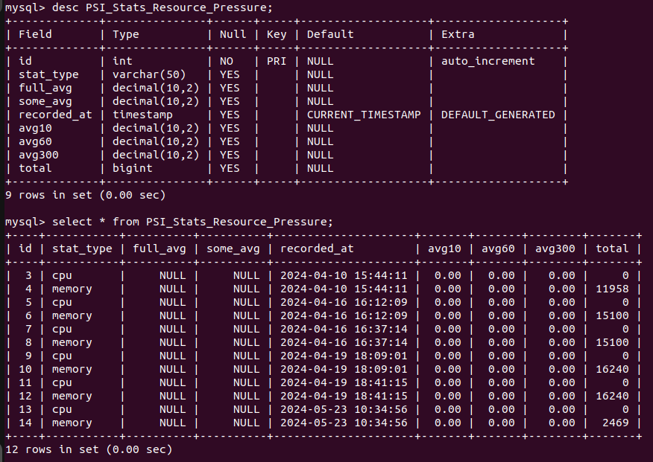
Database Structure and Output

